Slide 1

VSW04 Take Action: Go Fast with GitHub
Esteban Garcia
Head of GitHub AI Solutions, Lantern Microsoft MVP & Regional Director
Level: Intermediate

Slide 2





Esteban Garcia
Head of GitHub AI Solutions
estebangarcia
estebang
esteban.garcia@lanternstudios.com
https://repotocloud.com
https://lanternstudios.com/
@EstebanFGarcia

Slide 3

Session Survey
Your feedback is very important to us
Please take a moment to complete the session survey found in the mobile app
Use the QR code or search for “Converge360 Events” in your app store
Find this session on the Agenda tab
Click “Session Evaluation”
Thank you!

Slide 4
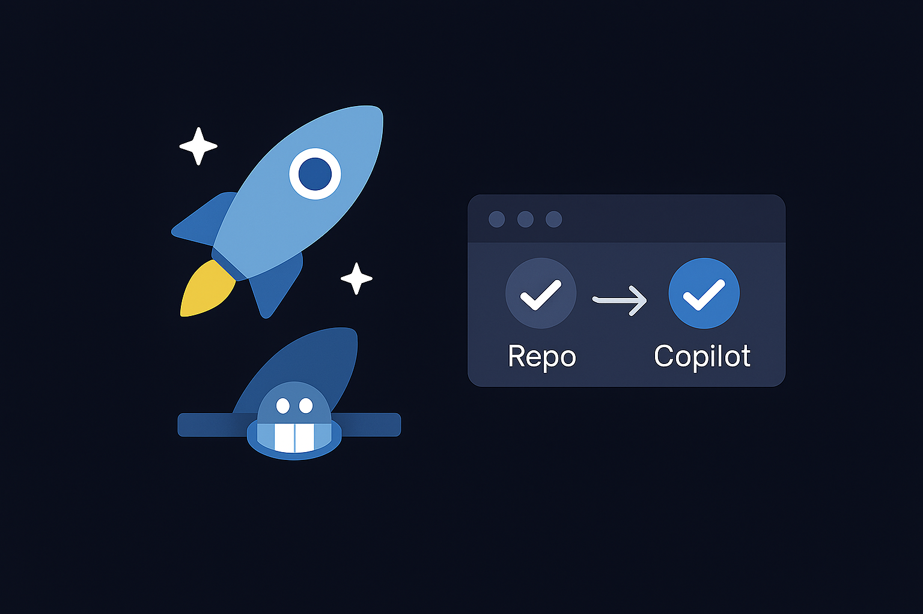
Session Goals
Cloud delivery is complex
Teams must move fast, securely, confidently
GitHub accelerates idea to production

Slide 5
Agenda
GitHub Actions
GitHub Copilot
Agent Mode
MCP in VS Code
Custom Agent
Demo
Q&A

Slide 6
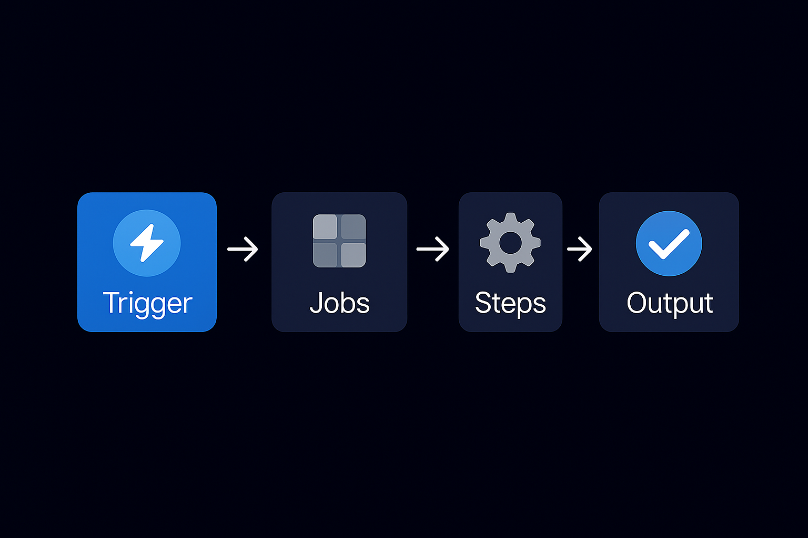
GitHub Actions
What is GitHub Actions?
Why use it your deployment journey?
Key concepts: Workflow, Jobs, Steps, Triggers

Slide 7
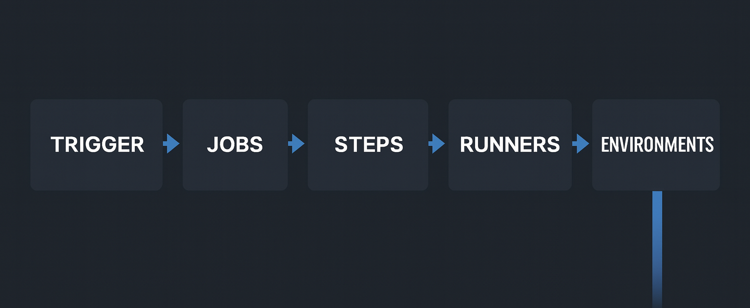
Workflow Anatomy

Slide 8
Demo: CI Pipeline
Build & test .NET app
Cache packages
Run on PR

Slide 9
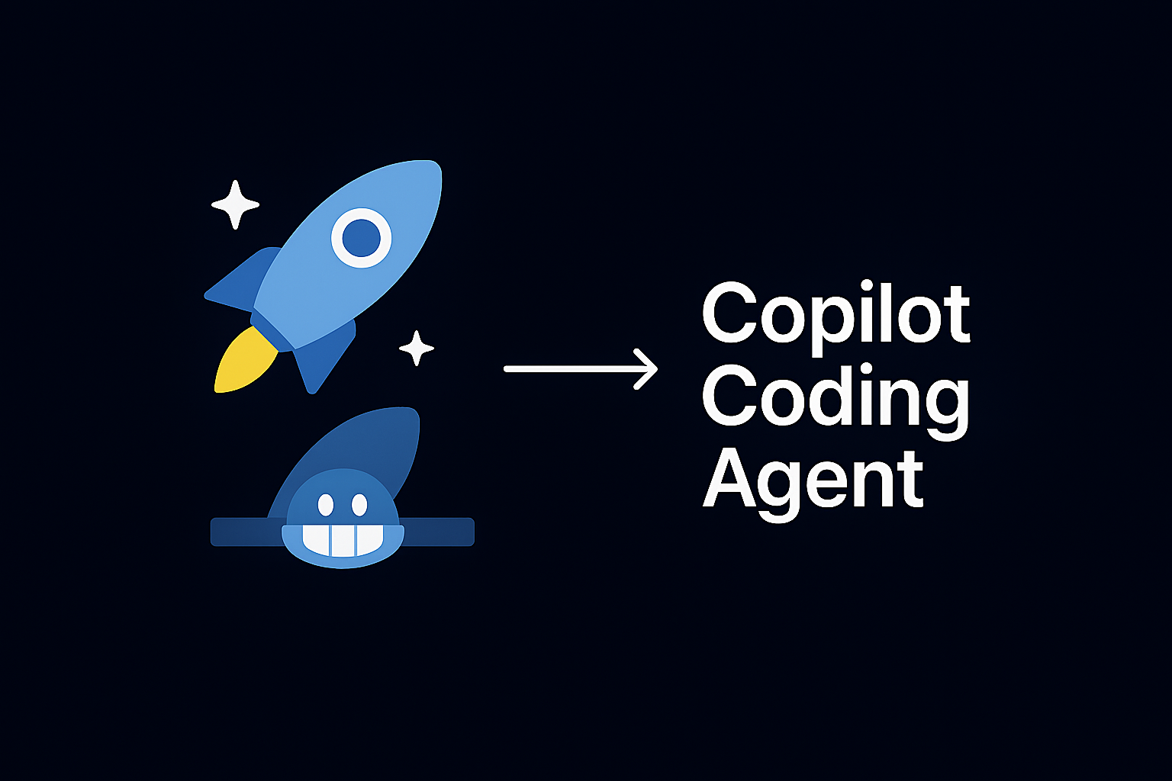
Copilot Coding Agent
What is Copilot Coding Agent?
Benefits: Context-aware coding, multi-step reasoning

Slide 10
Copilot for DevOps
Generate workflows
Explain failures
Optimize pipelines
Suggest patterns

Slide 11
Demo: Copilot Improves CI/CD
Generate CI/CD
Deploy to Azure
Environment structure

Slide 12
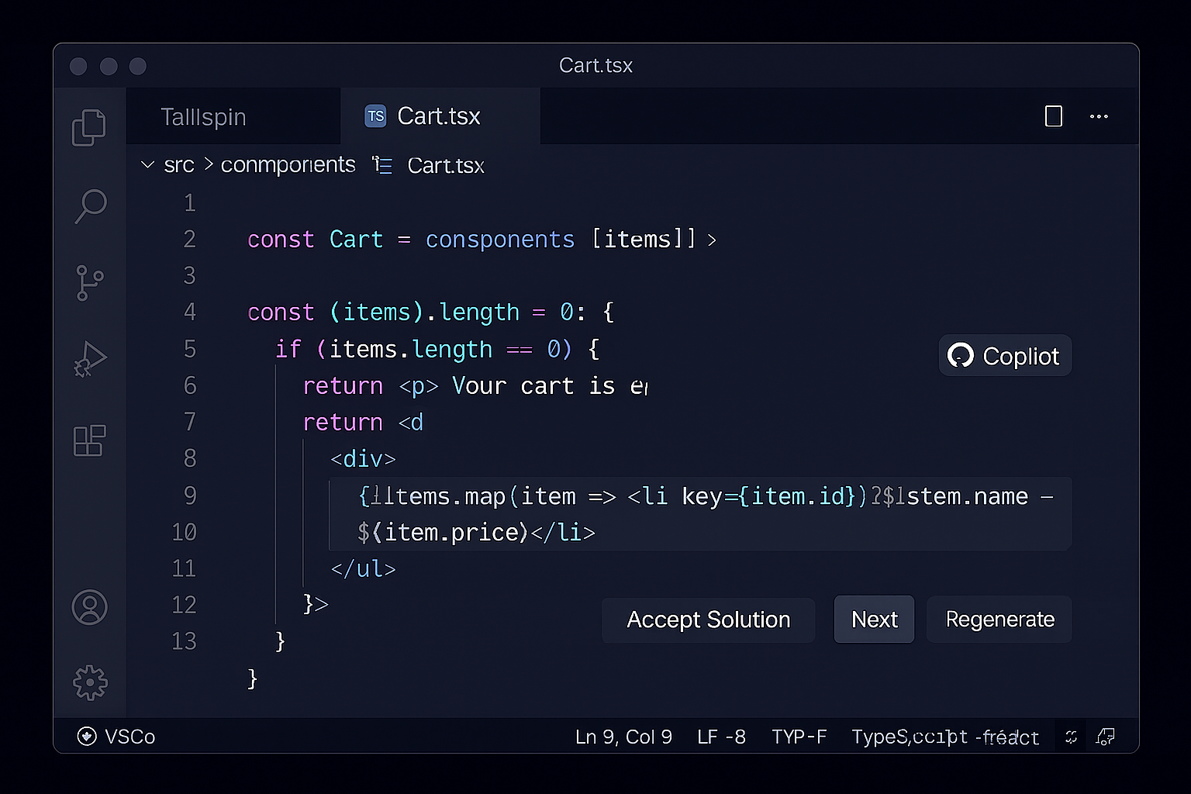
Agent Mode in VS Code
Working with Agent Mode
Multi-turn conversations, task execution

Slide 13
Demo: Agent Mode & Pipeline
Prompt → full CI/CD
env: dev + prod
deploy to Azure

Slide 14
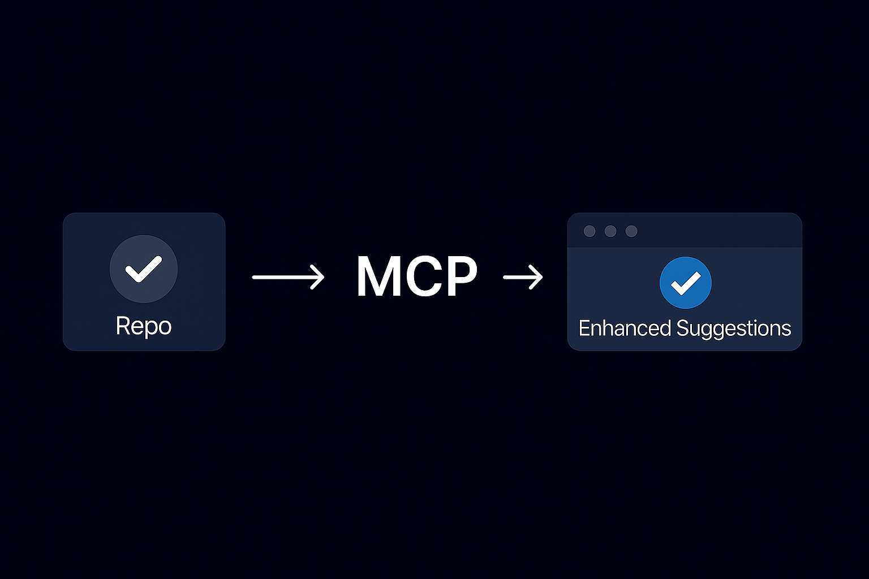
MCP (Model Context Protocol)
MCP enables structured context exchange
Improves AI understanding of project state
Query Issues
Analyze PRs
Inspect workflows
Connect SDLC elements

Slide 15
Demo: MCP
Show Issues & PRs within the IDE

Slide 16
Custom Agents
Golden paths
IaC standards
CI/CD consistency
Security baselines

Slide 17
Demo: Custom Agent
Analyze repo
Fix workflows
Add GHAS
Open PR

Slide 18
Demo Finale
Idea → Azure
CI → CD
Copilot → Agent Mode → MCP

Slide 19

What you can do tomorrow
Add CI
Improve pipelines
Try Agent Mode
Use MCP

Slide 20
Session Survey
Your feedback is very important to us
Please take a moment to complete the session survey found in the mobile app
Use the QR code or search for “Converge360 Events” in your app store
Find this session on the Agenda tab
Click “Session Evaluation”
Thank you!

Slide 21
Esteban Garcia
Head of GitHub AI Solutions
estebangarcia
estebang
esteban.garcia@lanternstudios.com
https://repotocloud.com
https://lanternstudios.com/
@EstebanFGarcia

